Slide 2
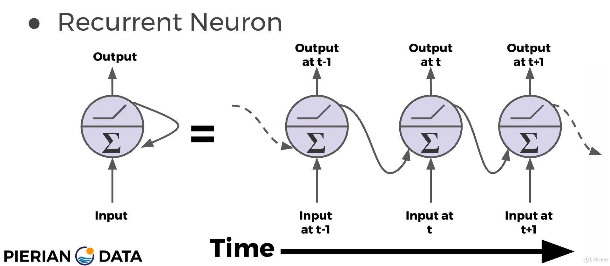
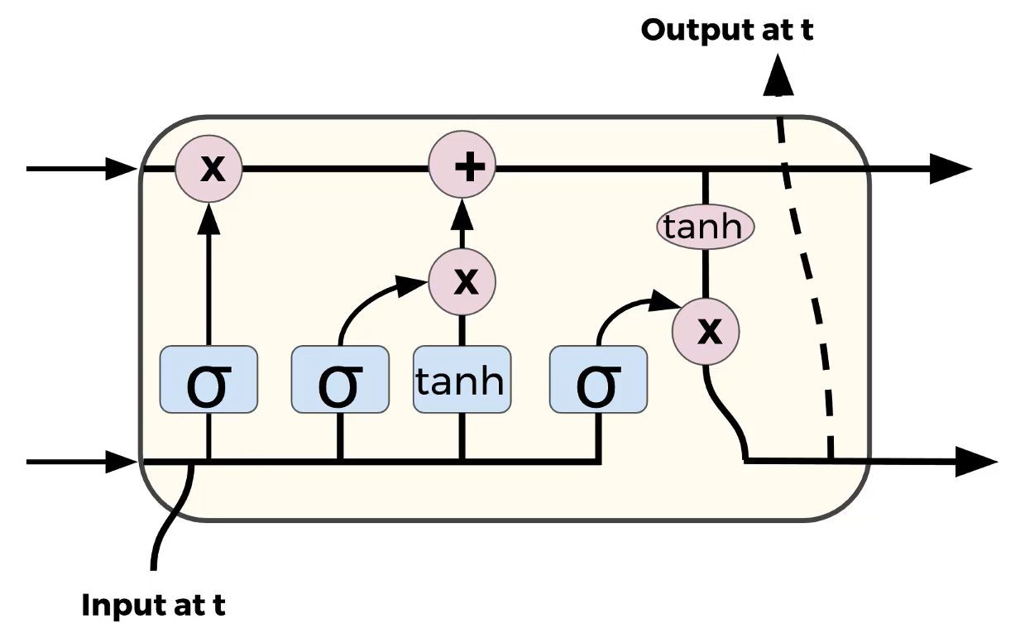
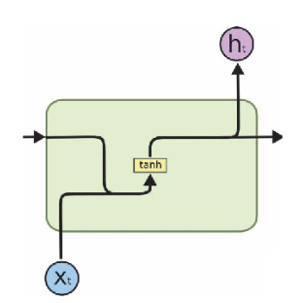

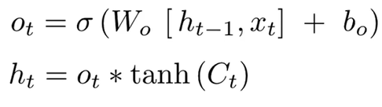

Recurrent Neural Network (SimpleRNN and LSTM)
Recurrent Neural Network
Forgetting
gate
Storing
gate
Output
Ct
ht-1
ht
xt
xt
Remembering older inputs while
dynamically updating the weights more recently!
Notes:
And since it is a time series problem which the actual rig counts is a reflection of previous rig counts and oil prices, we decided to try out Recurrent Neural Network to see if we could get a more reliable time sequence prediction. So, in RNN, each perceptron takes the input both from the current timestamp and previous timestamp. However, by implementing the simple RNN with a traditional memory cell like this, we found that our prediction accuracy were pretty low. Actually an issue RNN face is that after a while the network will begin to “forget” the first inputs as information is lost at each step going through the RNN.
In order to perform a robust method which takes a relatively long-term memory, we changed this perceptron to another kind LSTM here.
So in addition to the xt and ht-1 we also have a cell state and by passing the information into the cell which includes the forget gate, storing gate and output section, we end up passing the updated cell state as well as the output of the cell to the next neuron.
So this kind of architecture actually worked pretty well, and I would like to introduce my teammate Yong to share our modelling results.

